Slide 1

Temporal Analysis Performant Evolution
to positively empower enterprise with the INSIGHTS needed to win
https://github.com/shawnmccarthy/TEMPORAL
https://github.com/shawnmccarthy/TEMPORAL/projects/1

Slide 2

A) Research: TCN
Time series analysis is widely used in fields such as business, economics, finance, science, and engineering.
Our approach seeks to identify shifting economic phase and provide a framework for making asset allocation decisions according to the probability that asset may outperform or underperform.
Temporal Convolutional Networks have recently been applied to time series data where longer term memory of seasonality of the dataset are required
Research Encoder/Decoder and Knowledge Driven Event Embedding

Slide 3

Schedule
Week | Topic | Output
1 | Temporal Convolutional Network Analysis https://github.com/unit8co/darts | Schedule
2/3 | Standard TCN - Dilated Convolutional Layers https://towardsdatascience.com/temporal-coils-intro-to-temporal-convolutional-networks-for-time-series-forecasting-in-python-5907c04febc6 https://github.com/philipperemy/keras-tcn https://www.frbsf.org/economic-research/indicators-data/daily-news-sentiment-index/ | Stock Macro and Sector data
4/5 | Deep TCN http://www.gm.fh-koeln.de/ciopwebpub/Thill20a.d/bioma2020-tcn.pdf | Stock Macro and Sector data
6/7 | N-BEAT - Neural Basis Expansion Analysis Time Series Forecasting https://unit8co.github.io/darts/examples/07-NBEATS-examples.html | Stock Macro and Sector data
8/9 | Temporal Fusion Transformer https://ai.googleblog.com/2021/12/interpretable-deep-learning-for-time.html https://towardsdatascience.com/temporal-fusion-transformer-a-primer-on-deep-forecasting-in-python-4eb37f3f3594 https://unit8co.github.io/darts/examples/13-TFT-examples.html | Stock Macro and Sector data
10 | Spring Break
11/12/13 | Goal: Best Network for Temporal prediction of time series data (e.g. market data) | Summary of results

Slide 4
Schedule
Week | Topic | Output
14/15 | Knowledge-Driven Based event embedding Paulheim (2016) http://www.semantic-web-journal.net/system/files/swj1167.pdf | Design of embedding
16 | Prepare for phase 2

Slide 5
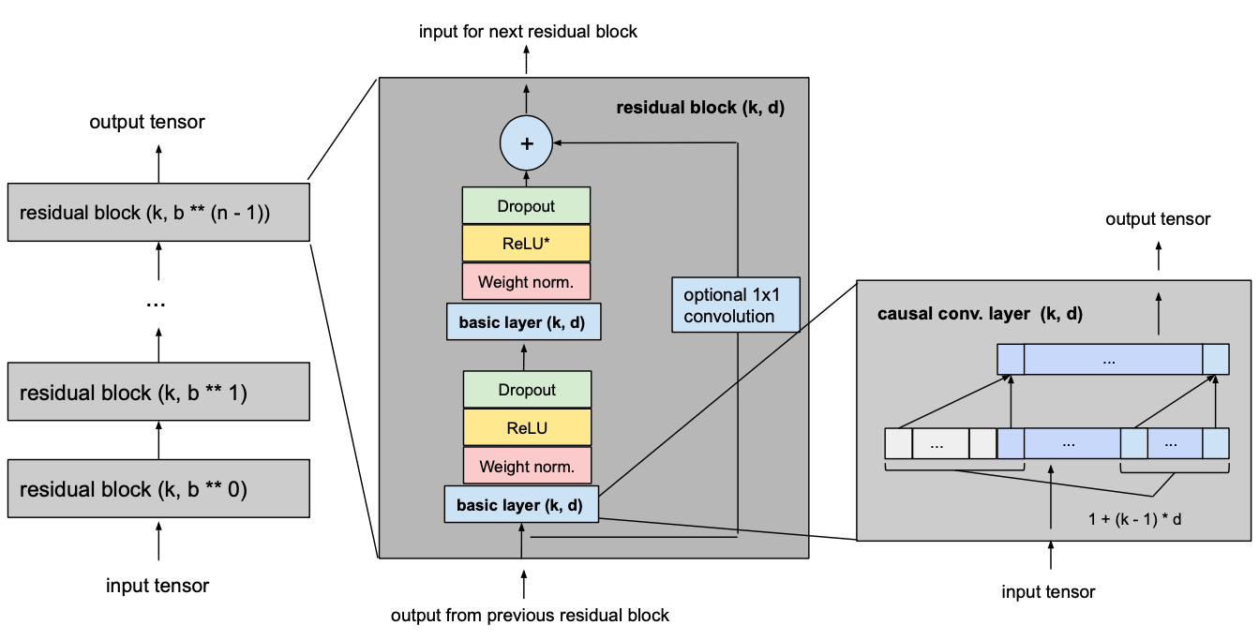
TCN Basic model
Given input_length, kernel_size, dilation_base and the minimum number of layers required for full history coverage, TCN network would look something like this
Consists of dilated, causal 1D convolutional layers with the same input and output lengths

Slide 6
Hyper Parameters
Weekly forecast
model = TCNModel( input_chunk_length=365, output_chunk_length=7, n_epochs=50, dropout=0.2, dilation_base=2, weight_norm=True, kernel_size=5, num_filters=8, nr_epochs_val_period=1, random_state=0, )
Periods to wait for Loss
Random weights
Notes:
To normalize the input of hidden layers (which counteracts the exploding gradient problem among other things), weight normalization is applied to every convolutional layer.
In order to prevent overfitting, regularization is introduced via dropout after every convolutional layer in every residual block. The following figure shows the final residual block.

Slide 7
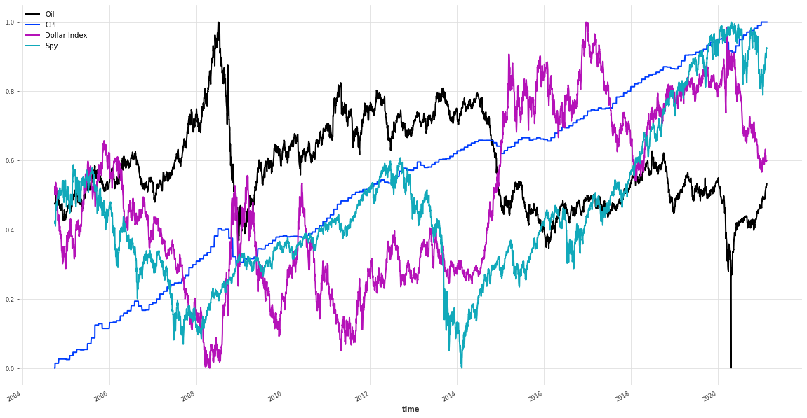
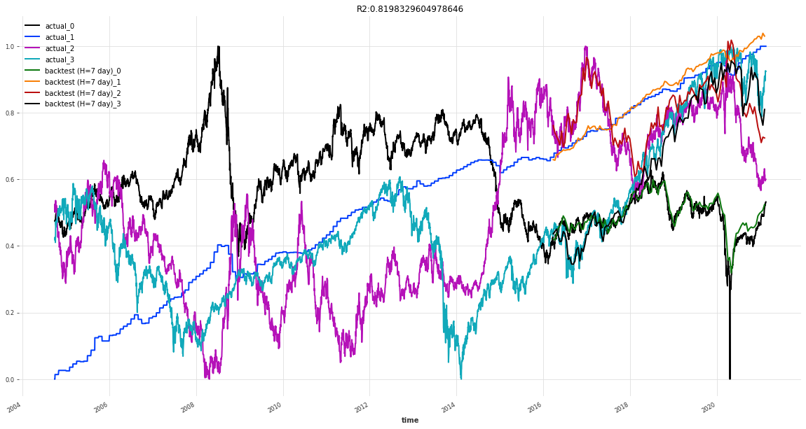
Oil, CPI, Dollar Index
Backtest RMSE = 0.03857457909272441
Notes:
R2 (coefficient of determination) regression score function.
It takes a time series, a starting point (here, we are starting at half of the series) and a forecast horizon. It returns the TimeSeries containing the historical forecasts would have been obtained when using the model to forecast the series with the specified forecast horizon (here 3 months), starting at the specified timestamp (using an expanding window strategy).

Slide 8

What’s Happened
Compare different hyper parameter sets to get a better understanding of kernel and dilation towards network and loss
Review covariate approach to pull in one additional knowledge

Slide 9
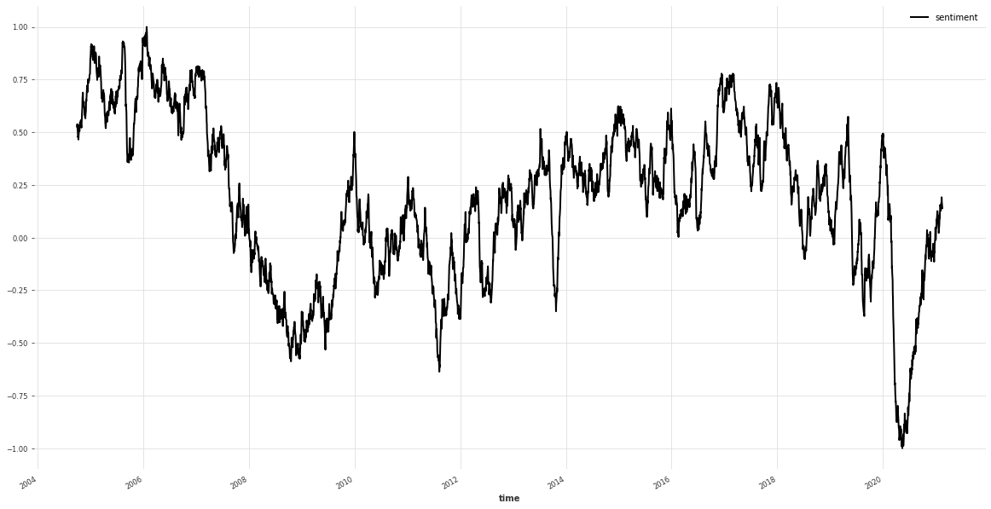




News sentiment
References
Buckman, Shelby R., Adam Hale Shapiro, Moritz Sudhof, and Daniel J. Wilson. 2020. “News Sentiment in the Time of COVID-19.” FRBSF Economic Letter 2020-08 (April 6).
Shapiro, Adam Hale, Moritz Sudhof, and Daniel J. Wilson. 2020. “Measuring News Sentiment.” FRB San Francisco Working Paper 2017-01.
The Data tab contains a news sentiment measure from January 1, 1980, to the latest day available.
$$s_{a}^{i}=f_{t(a)}^{i}+f_{p\left(a\right), j\left(a\right)}^{i}+ε_{a}^{i}$$
$$s_{a}^{i}$$
is the positivity score for article
is a sample-day (t) fixed effect
is a newspaper*type fixed effect
$$f_{t(a)}^{i}$$
$$f_{p\left(a\right), j(a)}^{i}$$

Slide 10
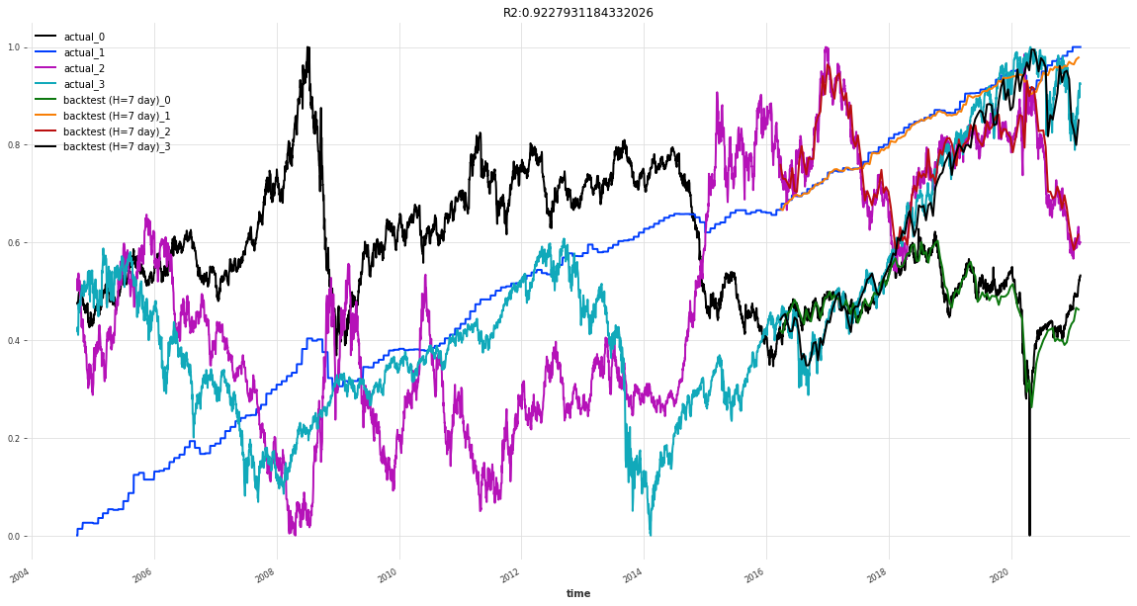
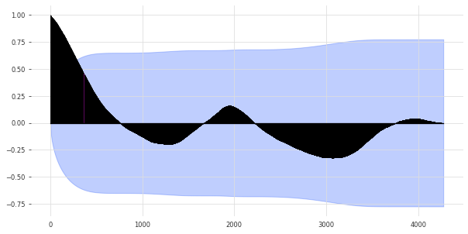
With covariate News
Backtest RMSE = 0.024682999973297988
seasonality = check_seasonality( ["Spy"], max_lag=len(series))
(True, 1943) = 5.3 years (*2018 - growing economy on average 3.2 years, recession 1.5 years)
Notes:
Plot the autocorrelation function
Plots lags on the horizontal and the correlations on vertical axis.

Slide 11
Different models
tcn_model(5, 2, train, val)
tcn_model(5, 2, train, val, train_cov, val_cov)

Slide 12
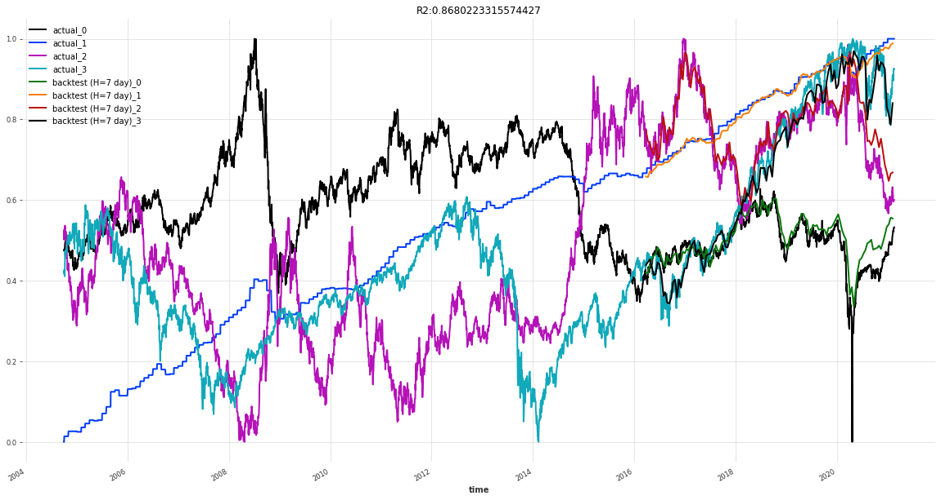

Different models
tcn_model(3, 2, train, val)
tcn_model(3, 2, train, val, train_cov, val_cov)

Slide 13
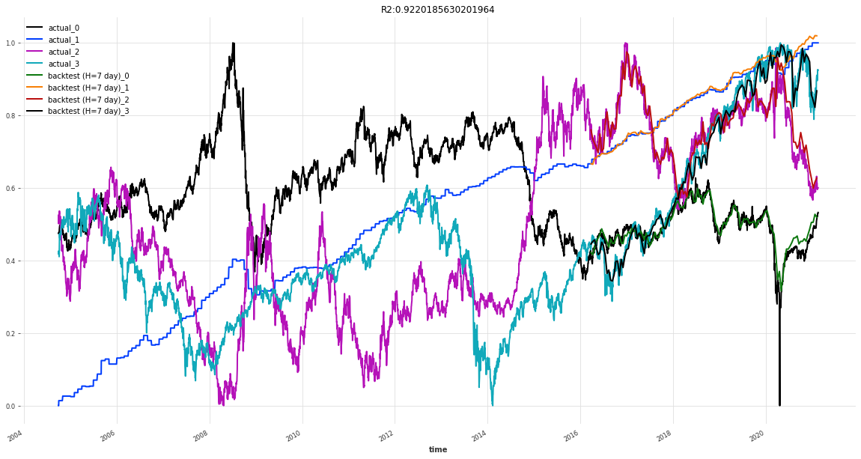
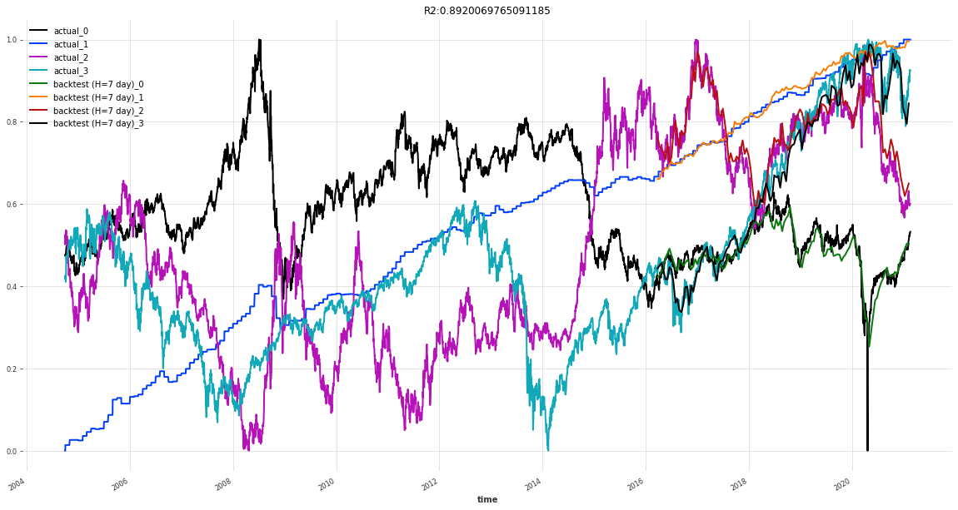
Different models
tcn_model(7, 2, train, val)
tcn_model(7, 2, train, val, train_cov, val_cov)

Slide 14
TCN Model
DeepTCN Models
Probabilistic forecasting using TCN model with Likelihood - GaussianLikelihood()

Slide 15
Guassian likelhoold
https://arxiv.org/pdf/1906.04397.pdf
Probabilistic Forecasting with Temporal Convolutional Neural Network
Yitian Chena , Yanfei Kangb,∗ , Yixiong Chenc , Zizhuo Wangd
Probabilistic forecasting framework based on convolutional neural network
Probabilistic forecasts of future observations can be achieved by directly predicting the parameters of the hypothetical distribution (e.g., the mean and the standard deviation for Gaussian distribution) based on maximum likelihood estimation

Slide 16
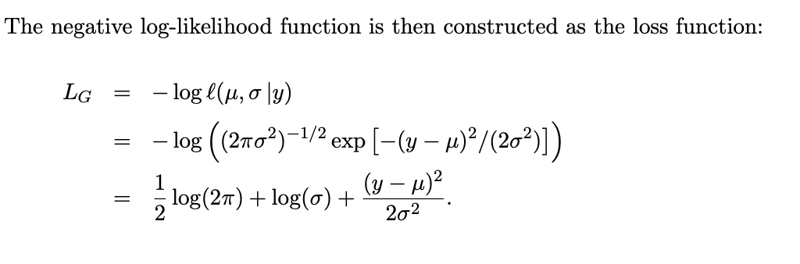
Parameter approach
Authors take Gaussian distribution as an example, for each target value y, the network outputs the parameters of the distribution, namely the mean and the standard deviation, denoted by µ and σ, respectively

Slide 17
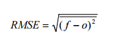
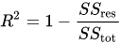
Comparison
 | 5/2 | 5/2 news | 3/2 | 3/2 news | 7/2 | 7/2 news
 | rsme --- R2 | rsme --- R2 | rsme --- R2 | rsme --- R2 | rsme --- R2 | rsme --- R2
TCN | 0.0385 --- 0.8198 | 0.0246 ---- 0.9227 | 0.0291 ---- 0.8680 | 0.0302 ---- 0.8694 | 0.0242 ---- 0.9220 | 0.0292 ---- 0.8920
TCN - Gaussian | 0.0248 --- 0.9187 | 0.0249 ---- 0.9119 | 0.0241 ---- 0.9183 | 0.0239 ---- 0.9273 | 0.0329 ---- 0.8737 | 0.0225 ---- 0.9289
Notes:
In statistics, the coefficient of determination, denoted R² or r² and pronounced "R squared", is the proportion of the variation in the dependent variable that is predictable from the independent variable(s).
1 would be perfect
Root Mean Squared Error (RMSE).
sum of squares of residuals / total sum of variances
Simply put between the observed outcomes and the observed predictor values
Here is my question MASE (Mean Absolute) or SMAPE symmetric Mean Absolute Percentage Error

Slide 18
What's next
N-Beats
Generic - uses as little prior knowledge as possible, with no feature engineering, no scaling and no internal architectural components
interpretable architecture consisting of two stacks: A trend stack and a seasonality stack. The architecture is designed so that:
The trend component is removed from the input before it is fed into the seasonality stack
The partial forecasts of trend and seasonality are available as separate interpretable outputs

Slide 19
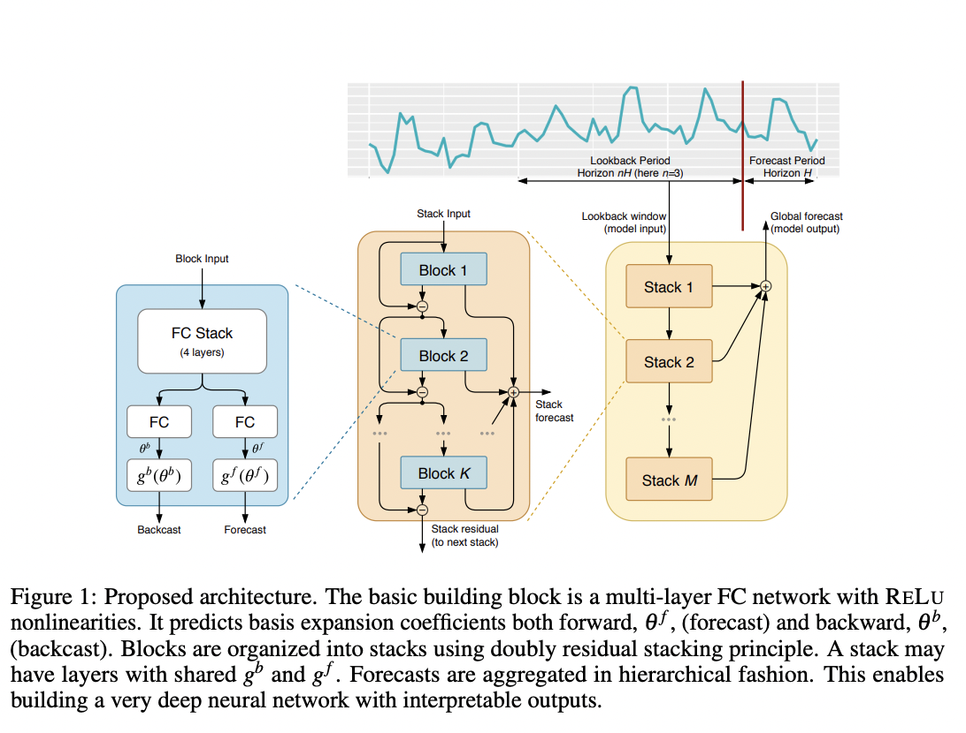
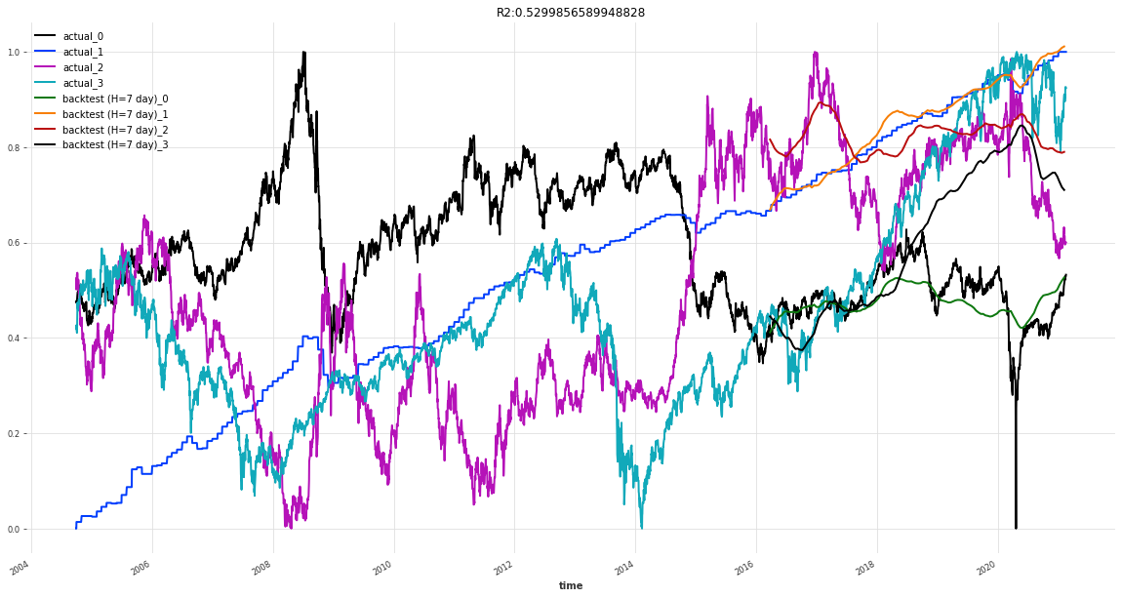
N-beats NEURAL BASIS EXPANSION ANALYSIS FOR INTERPRETABLE TIME SERIES FORECASTING
https://arxiv.org/pdf/1905.10437.pdf
Notes:
The generic architecture does not rely on TS-specific knowledge.
The interpretable architecture can be constructed by reusing the overall architectural approach in Fig. 1 and by adding structure to basis layers at stack level. Forecasting practitioners often use the decomposition of time series into trend and seasonality,
R square can have a negative value when the model selected does not follow the trend of the data, therefore leading to a worse fit than the horizontal line.

Slide 20
Comparison
 | 1/4/10 Block/ layer/ stack | 1/4/10 news | 3/4/10 | 3/4/10 news | 7/4/10 | 7/4/10 news
 | rsme --- R2 | rsme --- R2 | rsme --- R2 | rsme --- R2 | rsme --- R2 | rsme --- R2
N-BEATS | 0.2618 --- -8.9508 | 0.1718 ---- -6.8629 | 0.2372 ---- -4.7372 | 0.2022 ---- -4.2964 | 0.1859 ---- -1.5329 | 0.1637 ---- -2.595
N-BEATS Classic | 0.1044 -- -0.2296 | 0.1270 -- -0.3730 | 0.0796 -- 0.0281 | 0.1272 -- -0.9829 | 0.1201 -- -0.2906 | 0.1038 -- 0.0430
Notes:
In statistics, the coefficient of determination, denoted R² or r² and pronounced "R squared", is the proportion of the variation in the dependent variable that is predictable from the independent variable(s).
1 would be perfect
Root Mean Squared Error (RMSE).
sum of squares of residuals / total sum of variances
Simply put between the observed outcomes and the observed predictor values
Here is my question MASE (Mean Absolute) or SMAPE symmetric Mean Absolute Percentage Error

Slide 21
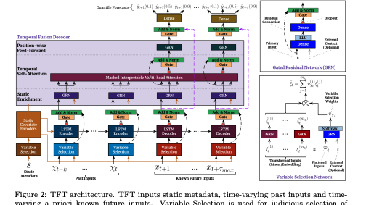
What's next
TFTModel incorporates the following main components from the original Temporal Fusion Transformer (TFT) architecture as outlined in this paper: https://arxiv.org/pdf/1912.09363.pdf
gating mechanisms: skip over unused components of the model architecture
variable selection networks: select relevant input variables at each time step.
temporal processing of past and future input with LSTMs (long short-term memory)
multi-head attention: captures long-term temporal dependencies
prediction intervals: per default, produces quantile forecasts instead of deterministic values
Notes:
– a novel attentionbased architecture which combines high-performance multi-horizon forecasting with interpretable insights into temporal dynamics.
To learn temporal relationships at different scales, TFT uses recurrent layers for local processing and interpretable self-attention layers for long-term dependencies.
Explainable

Slide 22
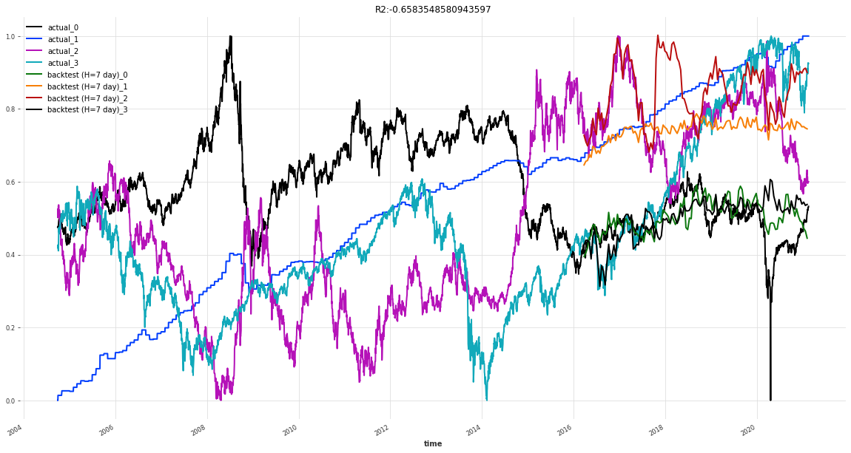
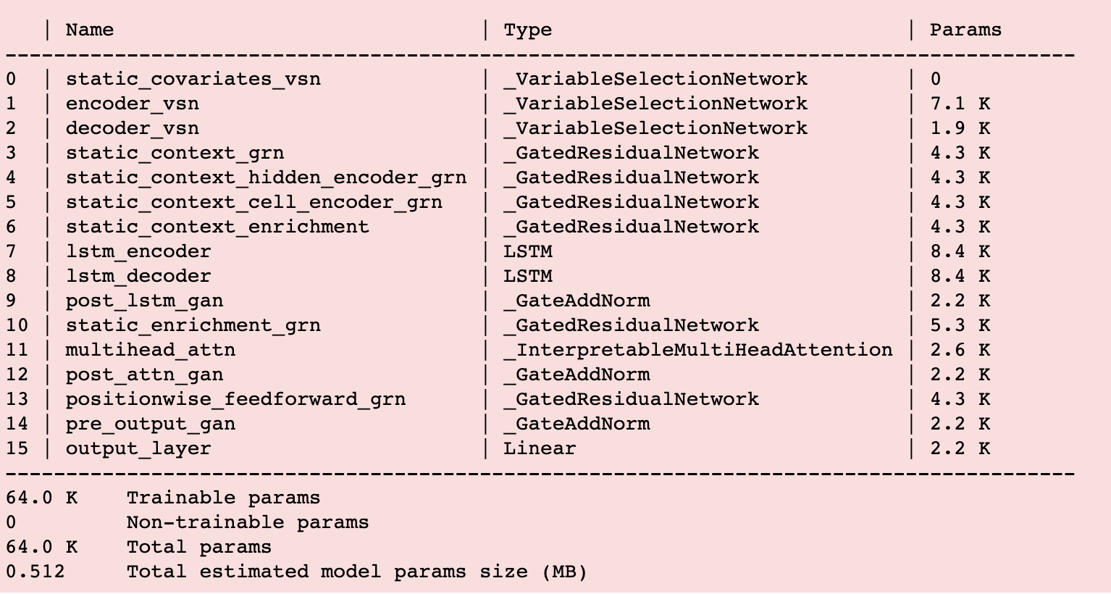
Results

Slide 23
Comparison
 | 32/1/4 Hidden/ layers/ attention | 32/1/4 news | 16/1/4 | 16/1/4 news | 24/1/4 | 24/1/4 news
 | rsme --- R2 | rsme --- R2 | rsme --- R2 | rsme --- R2 | rsme --- R2 | rsme --- R2
TFT - Q | 0.1475 --- -0.6583 | 0.1553 ---- -0.7481 | 0.1367 ---- -0.3632 | 0.1549 ---- -0.8424 | 0.1825 ---- -1.9988 | 0.1681 ---- -0.9694
TFT - Default | 0.1519 -- -0.6324 | 0.1871 -- -1.687 | 0.1450 -- -0.5103 | 0.1746 -- -1.4827 | 0.1482 -- -0.6002 | 0.1640 -- -1.563
Notes:
In statistics, the coefficient of determination, denoted R² or r² and pronounced "R squared", is the proportion of the variation in the dependent variable that is predictable from the independent variable(s).
1 would be perfect
Root Mean Squared Error (RMSE).
sum of squares of residuals / total sum of variances
Simply put between the observed outcomes and the observed predictor values
Here is my question MASE (Mean Absolute) or SMAPE symmetric Mean Absolute Percentage Error

Slide 24
Sentiment
The human raters of Vader used 5 heuristics to analyze the sentiment:
Punctuation — I love pizza vs I love pizza!!
Capitalization — I’m hungry!! vs I’M HUNGRY!!
Degree modifiers (use of intensifiers)— I WANT TO EAT!! VS I REALLY WANT TO EAT!!
Conjunctions (shift in sentiment polarity, with later dictating polarity) — I love pizza, but I really hate Pizza Hut (bad review)
Preceding Tri-gram (identifying reverse polarity by examining the tri-gram before the lexical feature— Canadian Pizza is not really all that great.

Slide 25
Financial – Polarity scores
https://www.frbsf.org/economic-research/files/wp2017-01.pdf
https://sraf.nd.edu/loughranmcdonald-master-dictionary/
Vader is a sentence-level sentiment classifier. It consists of both a lexicon—a list of several thousand words (“unigrams”) labeled from -4 to 4 corresponding to most negative to most positive— and a set of heuristic rules that account for a word’s context within the sentence.
Vader assigns a (net) negativity score to a sentence by aggregating across negativity scores of words within the sentence.

Slide 26
How it works
How it works: It counts the number of positive and negative words in the given text. If the number of positives is more than the negatives, it will return a positive sentiment. If both are equal, it will return a neutral sentiment.

Slide 27
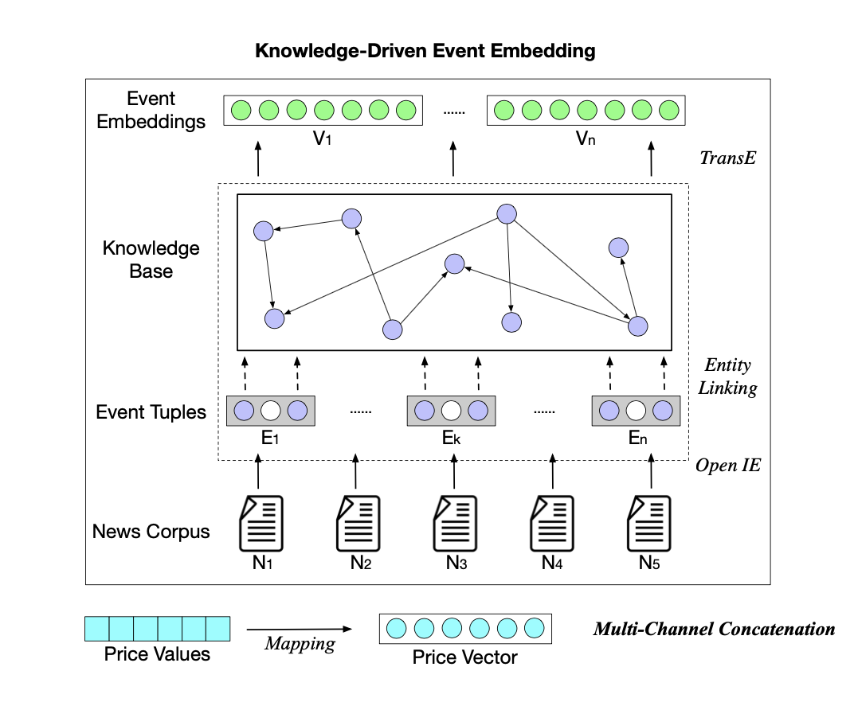
DECISION
Base Network: TCN Network – 90+%
Next week – Look at sentiment Analysis Improvements – sentence (topics) classification and sentiment analysis
Keyword | Correlation (Illustrative)
Financial | Financial
Energy | Energy, Oil
Technology | Consumer Discretionary
Health | Healthcare
Real estate | Real estate
Conflict | Consumer Staples, Industrials

Slide 28
NLP improvements
News sources
Conceptual Model
Nvidia NLP workshop

Slide 29
News sources
https://www.newsapi.ai/ | Archive to 2014, 150K news publishers
https://aylien.com/product/news-api/aggregate | Archive to 2012, 80K publishers
https://www.dowjones.com/professional/factiva/ https://developer.dowjones.com/datasets/details/news
https://newsapi.org/ | Oct 2017 https://pythoninvest.com/long-read/sentiment-analysis-of-financial-news
https://newscatcherapi.com/news-api
https://webz.io/data-apis/news-api | Archive to 2008
http://mlg.ucd.ie/datasets/bbc.html | 2004-2005
https://www.nature.com/articles/s41598-021-82338-6#ref-CR21 (Correlation)
Notes:
https://www.nature.com/articles/s41598-021-82338-6#MOESM1

Slide 30
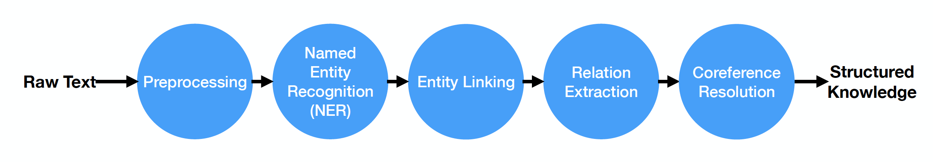
Advanced NLP

Slide 31
Conceptual model
Bring in news topics (6 keywords)
Knowledge Entity Recognition / Relation
Build Knowledge Graph
Sentiment Aggregate Score with Impact Relationship

Slide 32
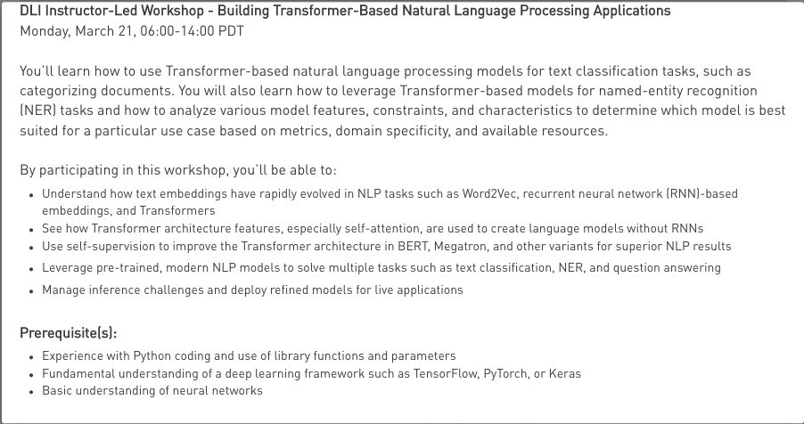
Spring break
8 hour Workshop
Nvidia GTC

Slide 33
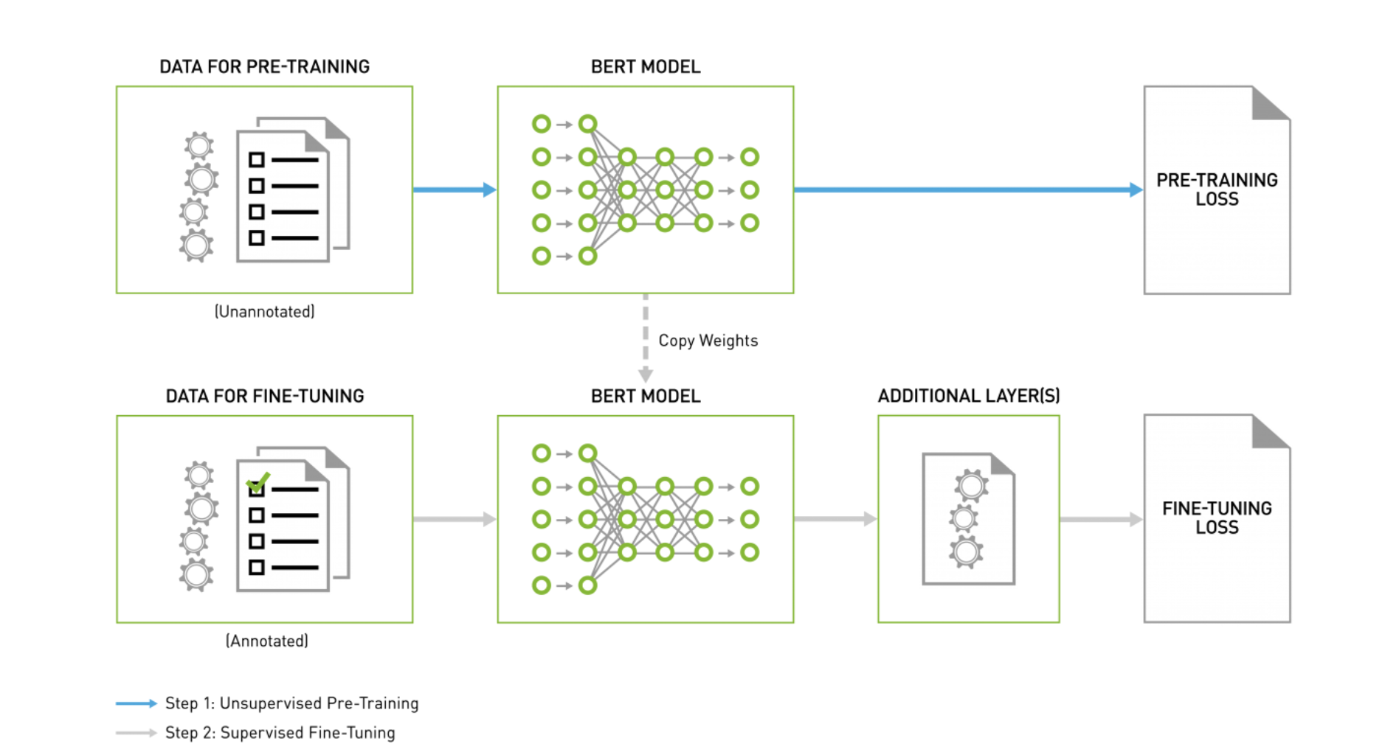
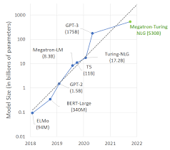
Conference
Large Models
Emotional – Wheel of Emotion

Slide 34
Main papers
Abstract | Citation
The proposed early warning system consists of five components, which includes the construction of mixed frequency investor sentiments that consider both macro and micro investor sentiments, the identification of stock market crisis, the determination of the forecast horizon using Ensemble Empirical Mode Decomposition (EEMD), the definition of the early warning signal, and the building of prediction model using artificial neural network (ANN) | Lu, Shan & Liu, Chenhui & Chen, Zhensong. (2021). Predicting stock market crisis via market indicators and mixed frequency investor sentiments. Expert Systems with Applications. 186. 115844. 10.1016/j.eswa.2021.115844. https://www.researchgate.net/publication/354471601_Predicting_stock_market_crisis_via_market_indicators_and_mixed_frequency_investor_sentiments
NLP techniques to understand news sentiment of 87 companies among the most reported on Reuters for a period of 7 years “Co-occurrence network” | Wan, X., Yang, J., Marinov, S. et al. Sentiment correlation in financial news networks and associated market movements. Sci Rep 11, 3062 (2021). https://doi.org/10.1038/s41598-021-82338-6 https://www.nature.com/articles/s41598-021-82338-6#MOESM1

Slide 35
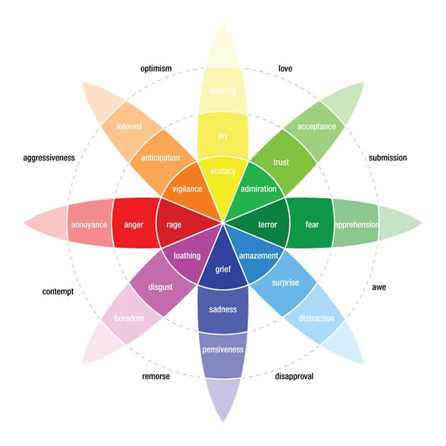
Emotion
Most do simple sentiment between values 0,1 (binary) or float (-1 to 1)
joy, trust, fear, surprise, sadness, disgust, anger, anticipation

Slide 36
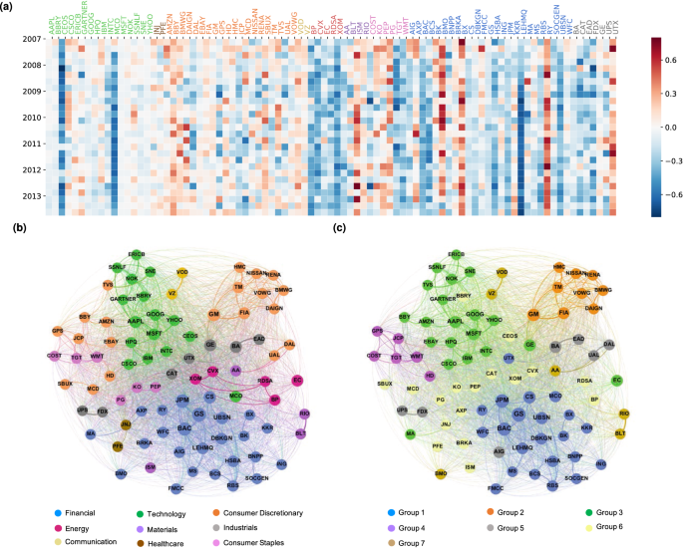
Co-occurrence
Co-occurrence network and sentiment distribution

Slide 37
Bringing it together
Request:
NewsCatcher (data goes back 2 years)
Amazon Sagemaker – Ground Truth Labeling of news data with emotion
Datasets:
Emotion Dataset
https://aclanthology.org/D18-1404.pdf
https://huggingface.co/datasets/emotion
Financial dataset (used for FinBERT)
https://huggingface.co/datasets/financial_phrasebank

Slide 38
NLP Component
Named Entity Recognition create co-occurrence network based on sector / macro (vs individual companies); may require much larger company list than what was used by Lu, Shan & Liu, Chenhui & Chen, Zhensong. (2021). Rather than co-occurrence between companies aggregate the companies into sectors and see co-occurrence between any sectors
Emotion analysis over simple sentiment – hypothesis is that fear vs negative and anticipation vs positive would be better predictors of market movement tied to media.

Slide 39
Sector data – Yahoo time series
Adding ETF sector data will provide insights on confirming the ETFs that perform better during a business cycle
https://finance.yahoo.com/etfs/
12 sectors – 120 companies
ETF | Sector | Companies
XLE (Energy Select) | Energy | Top 10 by holdings
GDX (Gold) | Gold Miners | Top 10 by holdings
XLB | Materials | Top 10 by holdings
DIA | Industrials | Top 10 by holdings
XLY | Consumer Discretionary | Top 10 by holdings
XLP | Consumer Staples | Top 10 by holdings
XLV | Health Care | Top 10 by holdings
XLF | Financials | Top 10 by holdings
XLK | Technology | Top 10 by holdings
IYZ | Telecommunication | Top 10 by holdings
XLU | Utilities | Top 10 by holdings
VNQ | Real estate | Top 10 by holdings
SPY | S&P 500 | Top 10 by holdings

Slide 40
Top 10 Holdings (76.93% of Total Assets)
Name | Symbol | % Assets
Exxon Mobil Corp | XOM | 23.70%
Chevron Corp | CVX | 20.03%
ConocoPhillips | COP | 4.64%
EOG Resources Inc | EOG | 4.46%
Schlumberger Ltd | SLB | 4.43%
Marathon Petroleum Corp | MPC | 4.17%
Pioneer Natural Resources Co | PXD | 4.08%
Phillips 66 | PSX | 4.07%
Kinder Morgan Inc Class P | KMI | 3.85%
Williams Companies Inc | WMB | 3.50%
Energy

Slide 41
Top 10 Holdings (62.45% of Total Assets)
Name | Symbol | % Assets
Newmont Corp | NEM | 15.50%
Barrick Gold Corp | ABX.TO | 11.23%
Franco-Nevada Corp | FNV.TO | 8.46%
Wheaton Precious Metals Corp | WPM.TO | 6.05%
Newcrest Mining Ltd | NCM.AX | 4.92%
Agnico Eagle Mines Ltd | AEM.TO | 4.31%
Kirkland Lake Gold Ltd | KL.TO | 3.55%
Northern Star Resources Ltd | NST.AX | 2.95%
Kinross Gold Corp | K.TO | 2.76%
Gold Fields Ltd ADR | GFI.JO | 2.72%
Gold

Slide 42
Top 10 Holdings (63.19% of Total Assets)
Name | Symbol | % Assets
Linde PLC | LIN.L | 15.91%
Sherwin-Williams Co | SHW | 6.90%
Air Products & Chemicals Inc | APD | 6.74%
Freeport-McMoRan Inc | FCX | 5.75%
Ecolab Inc | ECL | 5.42%
Newmont Corp | NEM | 5.37%
DuPont de Nemours Inc | DD | 4.42%
Dow Inc | DOW | 4.37%
PPG Industries Inc | PPG | 4.32%
International Flavors & Fragrances Inc | IFF | 3.99%
Materials

Slide 43
Top 10 Holdings (53.31% of Total Assets)
Name | Symbol | % Assets
UnitedHealth Group Inc | UNH | 7.74%
Goldman Sachs Group Inc | GS | 7.69%
The Home Depot Inc | HD | 6.07%
Microsoft Corp | MSFT | 5.62%
Salesforce.com Inc | CRM | 4.93%
McDonald's Corp | MCD | 4.42%
Honeywell International Inc | HON | 4.31%
Visa Inc Class A | V | 4.26%
Amgen Inc | AMGN | 4.19%
Boeing Co | BA | 4.08%
Industrials

Slide 44
Top 10 Holdings (69.58% of Total Assets)
Name | Symbol | % Assets
Amazon.com Inc | AMZN | 22.52%
Tesla Inc | TSLA | 14.25%
The Home Depot Inc | HD | 8.72%
Nike Inc Class B | NKE | 4.63%
McDonald's Corp | MCD | 4.51%
Lowe's Companies Inc | LOW | 3.67%
Starbucks Corp | SBUX | 3.53%
Target Corp | TGT | 3.11%
Booking Holdings Inc | BKNG | 2.41%
TJX Companies Inc | TJX | 2.23%
Consumer Discretionary

Slide 45
Top 10 Holdings (70.05% of Total Assets)
Name | Symbol | % Assets
Procter & Gamble Co | PG | 15.54%
Coca-Cola Co | KO | 9.88%
PepsiCo Inc | PEP | 9.63%
Walmart Inc | WMT | 9.11%
Costco Wholesale Corp | COST | 4.70%
Philip Morris International Inc | PM | 4.55%
Mondelez International Inc Class A | MDLZ | 4.44%
Altria Group Inc | MO | 4.35%
The Estee Lauder Companies Inc Class A | EL | 4.06%
Colgate-Palmolive Co | CL | 3.79%
Consumer Staples
Notes:
Consumer Staples

Slide 46
Top 10 Holdings (49.80% of Total Assets)
Name | Symbol | % Assets
Johnson & Johnson | JNJ | 9.19%
UnitedHealth Group Inc | UNH | 8.01%
Pfizer Inc | PFE | 4.64%
Abbott Laboratories | ABT | 4.36%
AbbVie Inc | ABBV | 4.21%
Thermo Fisher Scientific Inc | TMO | 4.20%
Merck & Co Inc | MRK | 4.17%
Eli Lilly and Co | LLY | 3.87%
Danaher Corp | DHR | 3.61%
Medtronic PLC | MDT | 3.54%
Health care

Slide 47
Top 10 Holdings (54.76% of Total Assets)
Name | Symbol | % Assets
Berkshire Hathaway Inc Class B | BRK.B | 12.83%
JPMorgan Chase & Co | JPM | 11.47%
Bank of America Corp | BAC | 7.57%
Wells Fargo & Co | WFC | 4.56%
Citigroup Inc | C | 3.56%
Morgan Stanley | MS | 3.32%
Goldman Sachs Group Inc | GS | 3.15%
BlackRock Inc | BLK | 3.02%
Charles Schwab Corp | SCHW | 2.66%
American Express Co | AXP | 2.62%
Financials

Slide 48
Top 10 Holdings (66.91% of Total Assets)
Name | Symbol | % Assets
Apple Inc | AAPL | 21.45%
Microsoft Corp | MSFT | 20.37%
NVIDIA Corp | NVDA | 4.98%
Visa Inc Class A | V | 3.95%
PayPal Holdings Inc | PYPL | 3.42%
Mastercard Inc A | MA | 3.19%
Adobe Inc | ADBE | 2.80%
Intel Corp | INTC | 2.26%
Salesforce.com Inc | CRM | 2.26%
Cisco Systems Inc | CSCO | 2.23%
Technology

Slide 49
Top 10 Holdings (78.92% of Total Assets)
Name | Symbol | % Assets
Cisco Systems Inc | CSCO | 24.15%
Verizon Communications Inc | VZ | 21.31%
Garmin Ltd | GRMN | 5.43%
Motorola Solutions Inc | MSI | 5.16%
Arista Networks Inc | ANET | 4.54%
AT&T Inc | T | 4.18%
T-Mobile US Inc | TMUS | 4.11%
Lumen Technologies Inc Ordinary Shares | LUMN | 3.56%
F5 Networks Inc | FFIV | 3.55%
Liberty Global PLC C | LBTYK.L | 2.93%
Telecommunications

Slide 50
Top 10 Holdings (64.09% of Total Assets)
Name | Symbol | % Assets
NextEra Energy Inc | NEE | 17.18%
Duke Energy Corp | DUK | 8.40%
Southern Co | SO | 7.26%
Dominion Energy Inc | D | 6.55%
Exelon Corp | EXC | 5.00%
American Electric Power Co Inc | AEP | 4.67%
Sempra Energy | SRE | 4.35%
Xcel Energy Inc | XEL | 3.86%
American Water Works Co Inc | AWK | 3.45%
Public Service Enterprise Group Inc | PEG | 3.37%
Utilities

Slide 51
Top 10 Holdings (45.68% of Total Assets)
Name | Symbol | % Assets
Vanguard Real Estate II Index | VRTPX | 11.53%
American Tower Corp | AMT | 7.49%
Prologis Inc | PLD | 5.62%
Crown Castle International Corp | CCI | 4.69%
Equinix Inc | EQIX | 4.23%
Public Storage | PSA | 2.87%
Digital Realty Trust Inc | DLR | 2.55%
Simon Property Group Inc | SPG | 2.43%
SBA Communications Corp | SBAC | 2.21%
Welltower Inc | WELL | 2.06%
Real estate

Slide 52
Top 10 Holdings (27.37% of Total Assets)
Name | Symbol | % Assets
Apple Inc | AAPL | 5.90%
Microsoft Corp | MSFT | 5.60%
Amazon.com Inc | AMZN | 4.05%
Facebook Inc A | FB | 2.29%
Alphabet Inc A | GOOGL | 2.02%
Alphabet Inc Class C | GOOG | 1.96%
Berkshire Hathaway Inc Class B | BRK.B | 1.45%
Tesla Inc | TSLA | 1.44%
NVIDIA Corp | NVDA | 1.37%
JPMorgan Chase & Co | JPM | 1.29%
S&P 500

Slide 53
Other considerations
https://nlp.stanford.edu/software/CRF-NER.html#Download
Stanford Named Entity Recognizer
Co-occurrence in same article
Dictionary approach to replace company names with sector
Additional Articles:
https://www.mdpi.com/1911-8074/12/1/45/htm (Co-occurrence)
https://www.frontiersin.org/articles/10.3389/fcell.2020.00673/full (BioNER)

Slide 54
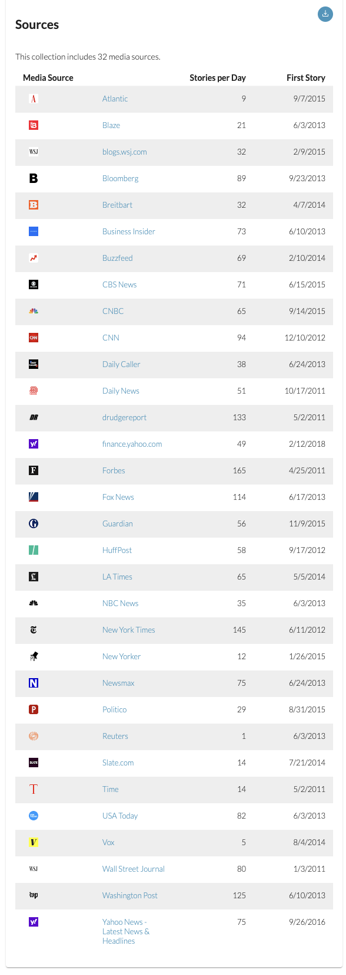
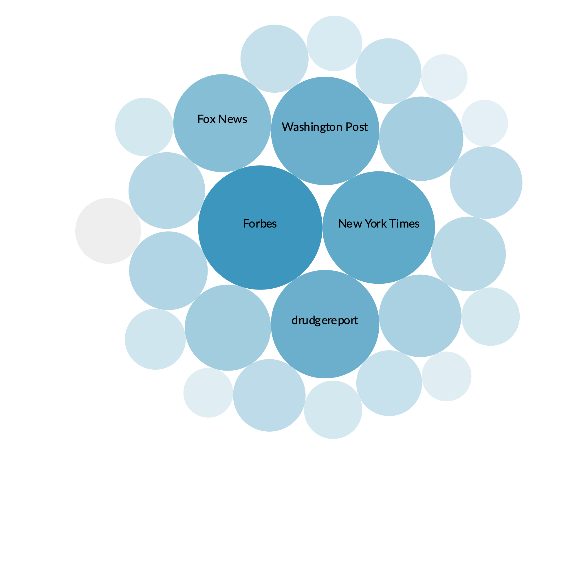
mediacloud
https://sources.mediacloud.org/#/collections/58722749
US Top News

Slide 55
Queries
sector | clause
Energy | (exxon OR chevron OR conoco OR "eog resources" OR "Schlumberger" OR "Marathon Petroleum" OR "Pioneer Natural Resources" OR Phillips OR "Kinder Morgan" OR "Williams Companies")
Gold Miners | (Newmont OR "Barrick Gold" OR "Franco-Nevada" OR "Wheaton Precious Metals" OR "Newcrest Mining" OR "Agnico Eagle Mines" OR "Kirkland Lake Gold" OR "Northern Star Resources" OR "Kinross Gold" OR "Gold Fields")
Materials | (Linde OR Sherwin-Williams OR "Air Products & Chemicals" OR "Freeport-McMoRan" OR "Ecolab" OR "Newmont" OR "DuPont de Nemours" OR DOW OR "PPG Industries" OR "International Flavors & Fragrances")
Industrials | ("UnitedHealth Group" OR "Goldman Sachs" OR "Home Depot" OR "Microsoft" OR Salesforce OR "McDonald's" OR "Honeywell International" OR "Visa" OR Amgen OR Boeing)
Consumer Discretionary | ("Amazon.com" OR Tesla OR "Home Depot" OR Nike OR "McDonald's" OR "Lowe's" OR Starbucks OR Target OR "Booking Holdings" OR "TJX Companies")
Consumer Staples | ("Procter & Gamble" OR "Coca-Cola" OR "PepsiCo" OR Walmart OR "Costco Wholesale" OR "Philip Morris International" OR "Mondelez International" OR "Altria Group" OR "Estee Lauder Companies" OR "Colgate-Palmolive")
Health Care | ("Johnson & Johnson" OR "UnitedHealth Group" OR Pfizer OR "Abbott Laboratories" OR AbbVie OR "Thermo Fisher Scientific" OR "Merck & Co" OR "Eli Lilly" OR "Danaher" OR "Medtronic")
Financials | ("Berkshire Hathaway" OR "JPMorgan Chase" OR "Bank of America" OR "Wells Fargo" OR "Citigroup" OR "Morgan Stanley" OR "BlackRock" OR "Charles Schwab" OR "American Express")
Technology | (Apple OR Microsoft OR Apple OR Nvidia OR Visa OR PayPal OR Mastercard OR Adobe OR Intel OR Salesforce OR "Cisco Systems")
Telecommunications | ("Cisco Systems" OR "Verizon Communications" OR Garmin OR "Motorola Solutions" OR "Arista Networks" OR "AT&T" OR "T-Mobile" OR "Lumen Technologies" OR "F5 Networks" OR "Liberty Global")
Utilities | ("NextEra Energy" OR "Duke Energy" OR "Southern Co" OR "Dominion Energy" OR Exelon OR "American Electric Power" OR "Sempra Energy" OR "Xcel Energy" OR "American Water Works" OR "Public Service Enterprise")
Real estate | ("Vanguard Real Estate" OR "American Tower" OR "Prologis" OR "Crown Castle International" OR Equinix OR "Public Storage" OR "Digital Realty Trust" OR "Simon Property Group" OR "SBA Communications" OR Welltower)

Slide 56

Download news
Call Media Cloud (based on sector query) get all stories from 2018-01-01 to 2021-01-01
Download articles
Write TSV (media, url, title, publish date, summary, text)

Slide 57
Number of articles downloaded
40,284
Sector | Articles
Energy | 1408
Gold Miners | 725
Materials | 7256
Industrials | 6109
Consumer Discretionary | 7095
Consumer Staples | 2755
Health Care | 859
Financials | 3871
Technology | 4976
Telecommunications | 1996
Utilities | 1774
Real estate | 1460

Slide 58
Next steps
Tune
Fine tune model on emotional sentiment - https://huggingface.co/datasets/emotion
Compare
Compare BERT, RoBERTa and Megatron
Classify
Classify articles

Slide 59
Process
BERT
109M
Emotion
Twitter data
News
Summary

Slide 60
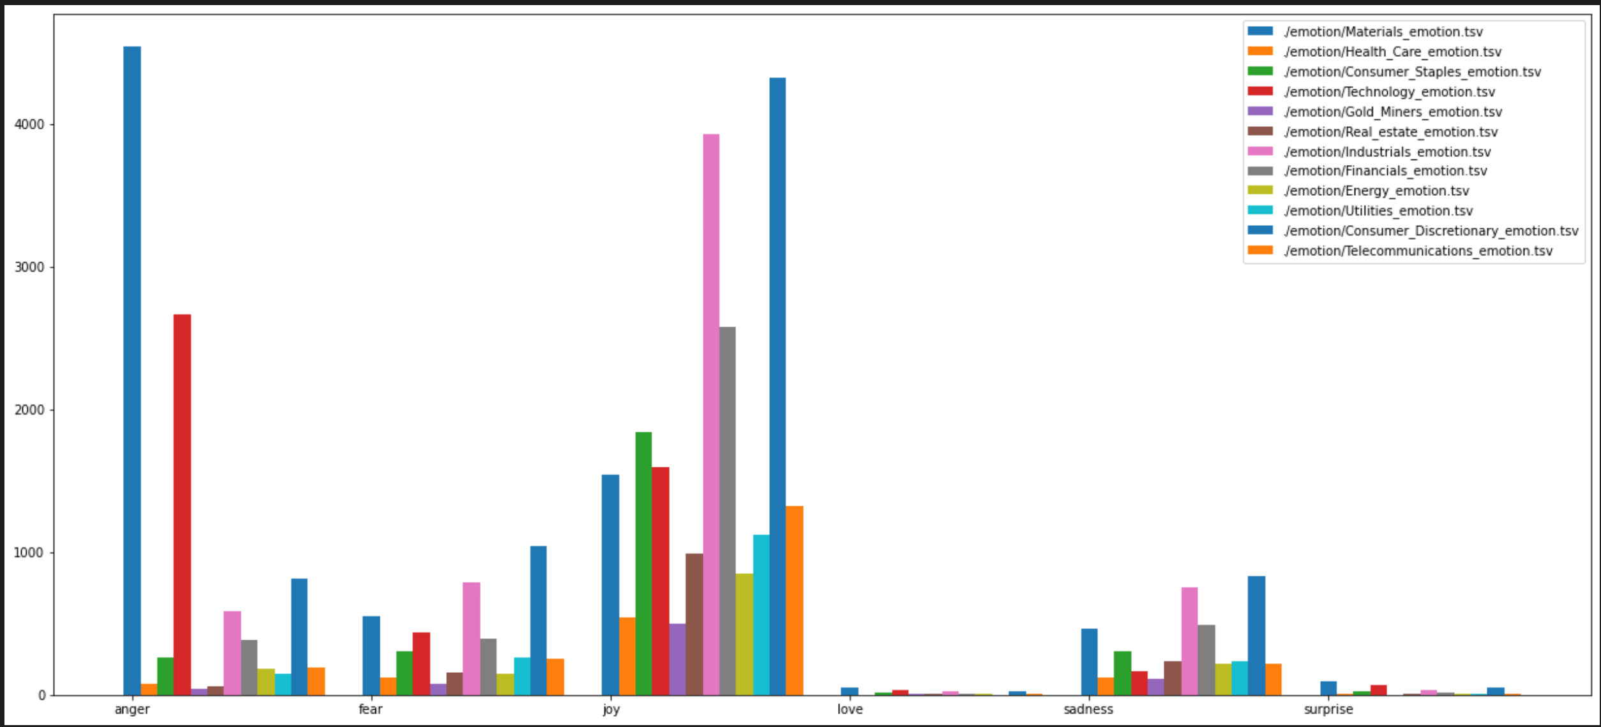
Something doesn’t look right…

Slide 61
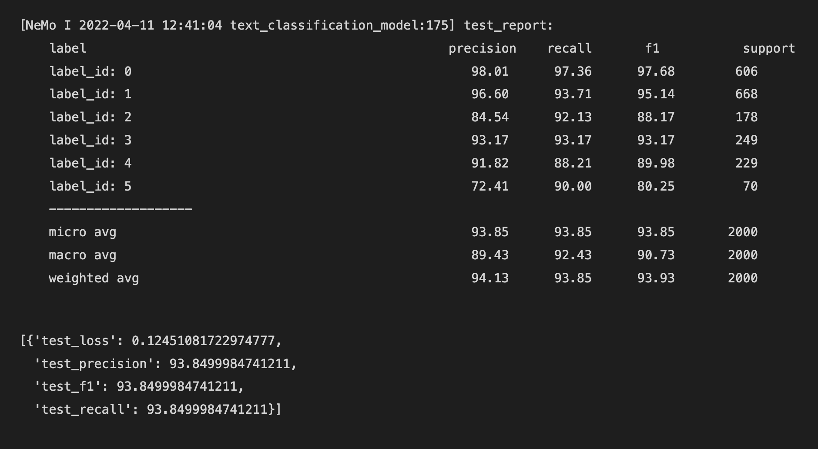
BERT model applied to news
“Palm Springs has just ushered in America’s first all-LGBT city council and this is what it’s doing to celebrate: nothing. Mayor Robert Moon, left, and the rest of Palm Springs’ new all-LGBT city council: Christy Gilbert Holstege, JR Roberts, Lisa Middleton, Geoff Kors. Palm Springs, a 47,000-strong community which boasts fine dining, galleries and mid-century architecture, feels like a parallel universe. Christy Holstege, a newly elected member of Palm Springs’ all-LGBT city council. Gay vacationers flocked here in recent decades because it was discreet – what happened in Palm Springs stayed in Palm Springs – and many ended up staying”
Ask a Fool: How can I protect against 2018 market correction? Many experts are calling for a market correction in 2018. Healthcare conglomerate Johnson & Johnson is another case in point, with its predictable cash flow and the recession-resistant, nondiscretionary nature of its core products. Offer from the Motley Fool: Offer from The Motley Fool: The 10 best stocks to buy nowMotley Fool co-founders Tom and David Gardner have spent more than a decade beating the market. In fact, the newsletter they run, Motley Fool Stock Advisor, has tripled the S&P 500!

Slide 62
Other lessons learned
Docker Containers
Shared Memory default 64M
Binding Host Folder
Visual Studio Code
Great support for remote docker development

Slide 63
Next experiment – larger models
RoBERTa - roberta-large-mnli
Bert - bert-large-uncased

Slide 64
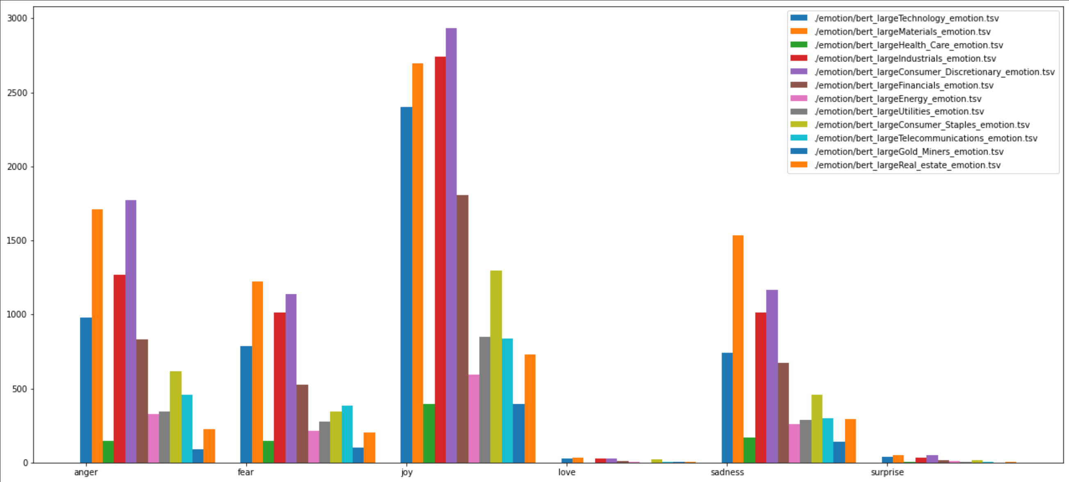
bert-large-uncased

Slide 65
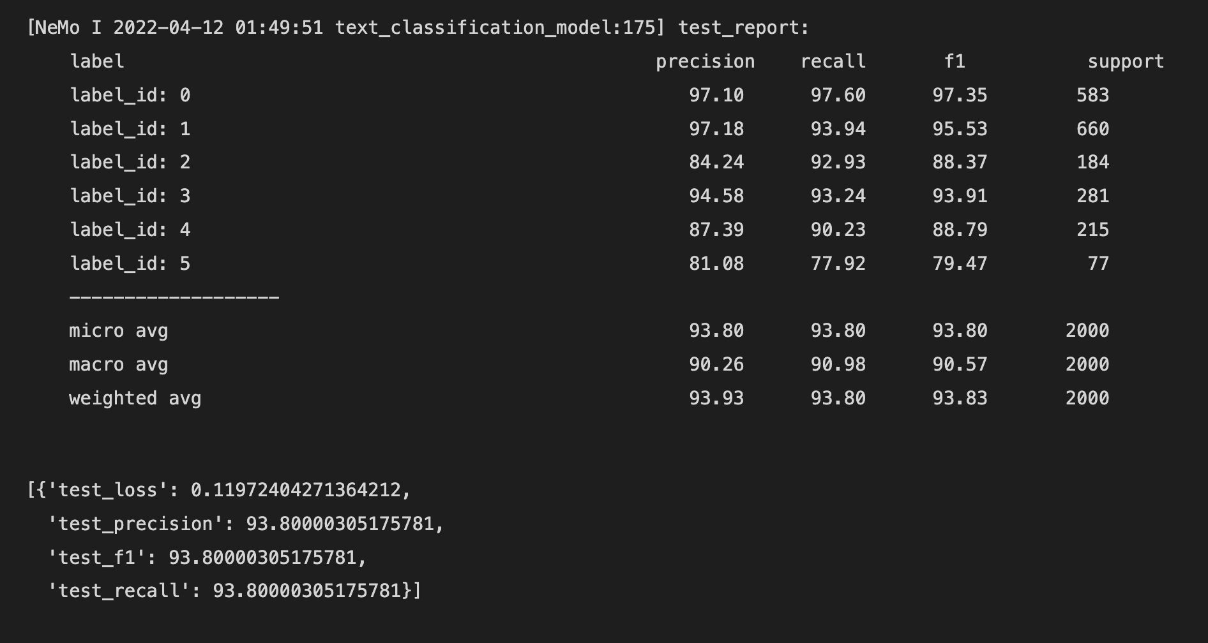
BERT model applied to news
“Lou Williams scores 40 points, Clippers hold off HornetsLOS ANGELES (AP) — Clippers guard Lou Williams was trouble for the Charlotte Hornets from the moment he left the bench, making his first four shots, including three 3-pointers, and scoring 11 points before he was on the floor four minutes. Williams went on to score 40 points to lead Los Angeles to a 106-98 victory Sunday. In an offensive struggle for both teams, the Clippers outshot the Hornets 47 percent to 39 percent to win for the fifth time in six games. Blake Griffin added 25 points in his second game back after missing 14 with a left MCL strain. The Hornets held the Clippers to 2-of-15 from the field during the stretch.”
The Hugh Jackman-as-PT Barnum biopic earned another $15.5 million in its second Fri-Sun frame and $20.75m over the Fri-Mon frame. Paramount/Viacom Inc.'s Downsizing earned $4.7 million (-2%) over its second Fri-Sun weekend for a $6.1, Fri-Mon frame. The Jessica Chastain/Idris Elba drama earned around $3.11 million over the Fri-Mon frame for a $6m eight-day cume. Ditto the acclaimed Hostiles, which will make around $34k over this Fri-Mon frame in five theaters for an $86k domestic cume. And the $20m Jacob Tremblay/Julia Roberts/Owen Wilson drama has earned nearly $198.5m worldwide, so it'll cross $200m... maybe today?

Slide 66
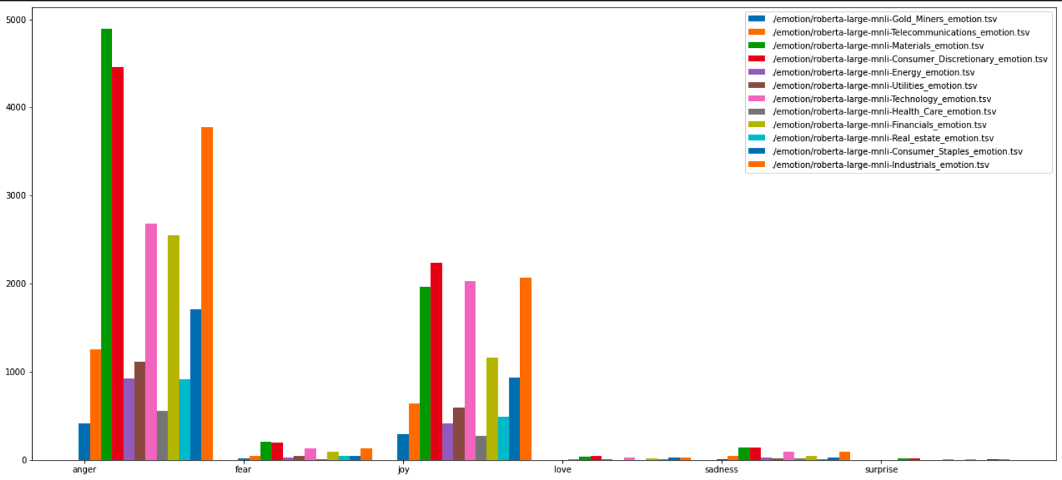
Roberta

Slide 67
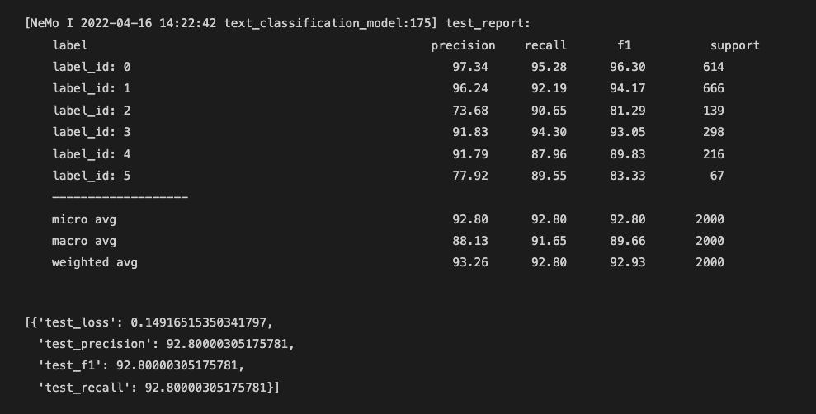
roberta model applied to news
“The stock's slide stands in stark contrast to the price of gold's 2.9% rise through the month -- a noteworthy observation, since the price movements of gold stocks often follow movements in the price of gold. So whatW hereas the company, in fiscal 2016, exceeded gold production guidance, it failed to achieve the same feat in fiscal 2017. Reporting gold production of 5.32 million ounces in fiscal 2017, Barrick came up short of the forecast, 5.6 million ounces to 5.9 million ounces, which it had forecast in February 2017. Initially, management forecast fiscal 2018 gold production between 4.8 million ounces and 5.3 million ounces; however, citing lower production at its operations in Nevada, Pueblo Viejo, and Veladero, management now expects gold production of 4.5 million to 5 million ounces. For fiscal 2017, Barrick reported that all-in sustaining costs (AISC) rose approximately 3% year over year to $750 per gold ounce”

Slide 68
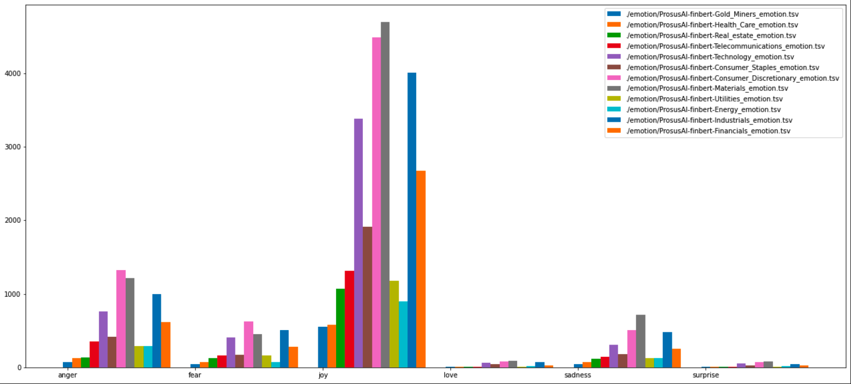
Finbert

Slide 69
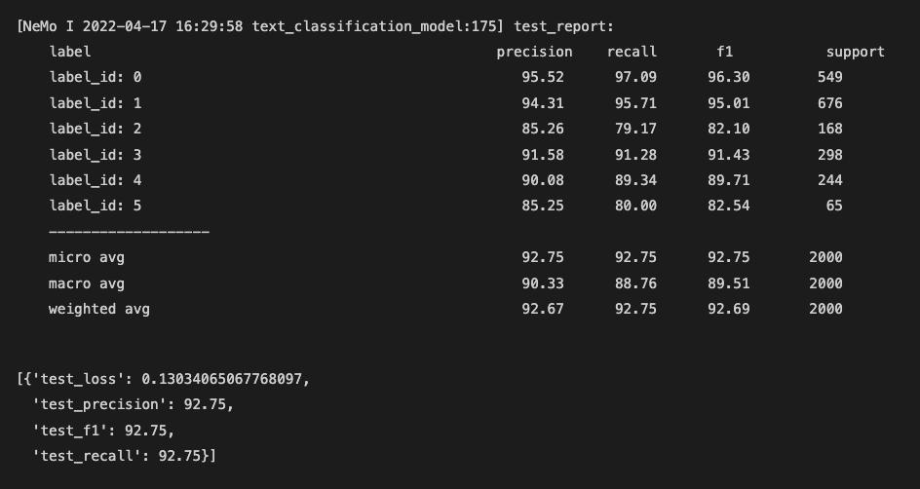
finbert model applied to news
“More New Yorkers have died from opioid overdoses than car crashes and homicides combined in recent years. ‘Big Pharma’ helped to fuel this epidemic by deceptively peddling these dangerous drugs and hooking millions,” De Blasio said. Q&A Why is there an opioid crisis in America? Show Almost 100 people are dying every day across America from opioid overdoses – more than car crashes and shootings combined. Belated efforts to rein in distribution fueled a resurgence of heroin and the emergence of a deadly, black market version of the synthetic opioid fentanyl”

Slide 70
Summary
Model | Test Loss | Test Precision | Test F1 | Test Recall | Weighted Avg Precision | Observation
BERT Large | 0.119 | 93.9 | 93.8 | 93.8 | 93.83 | Mainly Joy, Even between Anger, Fear Sadness
Roberta | 0.149 | 92.8 | 92.8 | 92.8 | 93.26 | Mostly anger
FinBert | 0.13 | 92.75 | 92.75 | 92.75 | 92.67 | Mostly joy

Slide 71
Next steps – next two weeks
Source new data – News API will offer me an academic discount
Going to do some count analysis
Mechanical Turk: https://www.mturk.com/ based on estimates above will request crowdsourcing option
Start Graph modeling code
Analyze Paper: https://www.researchgate.net/publication/354471601_Predicting_stock_market_crisis_via_market_indicators_and_mixed_frequency_investor_sentiments

Slide 72
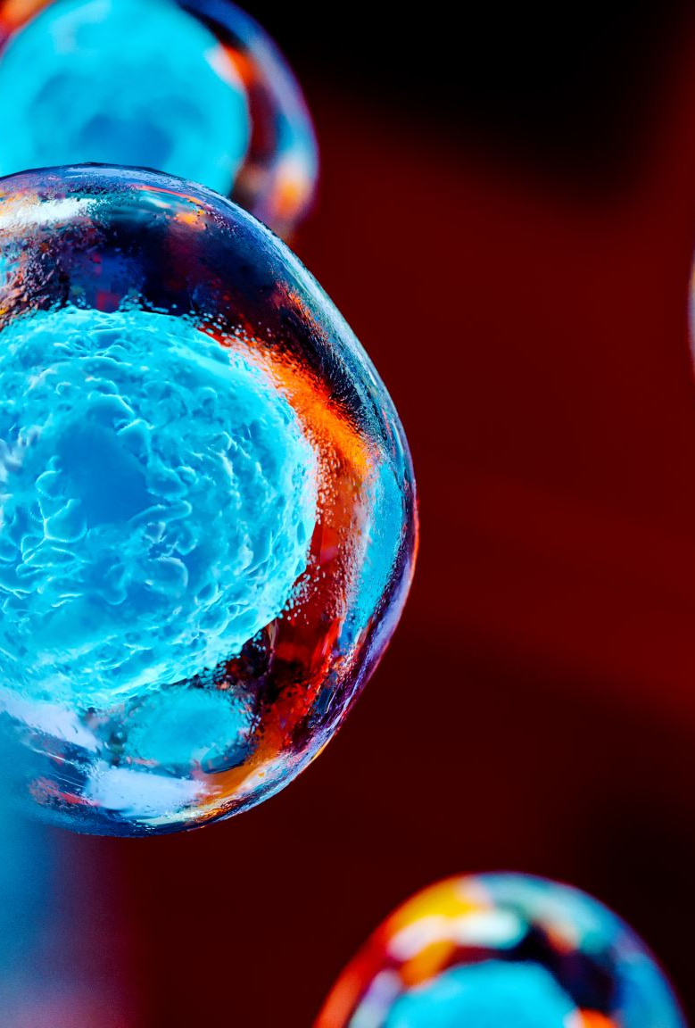

Final Concept
Genetic Algorithms applied to Temporal Convulsion Networks
Temporal Analysis Performant Evolution

Slide 73
Initial thoughts
A) Research: Temporal Convolutional Network
Dilated Convolutional Layers
Encoder/Decoder
B) Research: Genetic Algorithms
Apply to layers and hyper parameters
C) Applied: TCN – Performant Evolution – Supervised
Apply TCN network design and genetic algorithm approach to time series problem
Goal: Best Network for Temporal prediction of time series information (e.g. market data)
Output experiments across more recent designs (encoder/decoder)
Goal: Determine best genetic algorithms that can be applied (parameter tuning, black-box, binary gene encoding, adaptive) and fitness functions to apply
Output experiments across different genetic algorithms
Goal: Compare backpropagation to evolutionary approach
Output experiments across
D) Applied: TCN – Performant Evolution – Including Events
Knowledge driven events (negative effects causing abrupt changes)
Continuous learning (stream real-time data)
Output experiments across more recent designs (knowledge graphs / news events / current stock data)
Incorporate abrupt model (negative effect)

Slide 74
A) Research: TCN
Time series analysis is widely used in fields such as business, economics, finance, science, and engineering.
Our approach seeks to identify shifting economic phase and provide a framework for making asset allocation decisions according to the probability that asset may outperform or underperform.
Temporal Convolutional Networks have recently been applied to time series data where longer term memory of seasonality of the dataset are required
Research Encoder/Decoder and Knowledge Driven Event Embedding

Slide 75
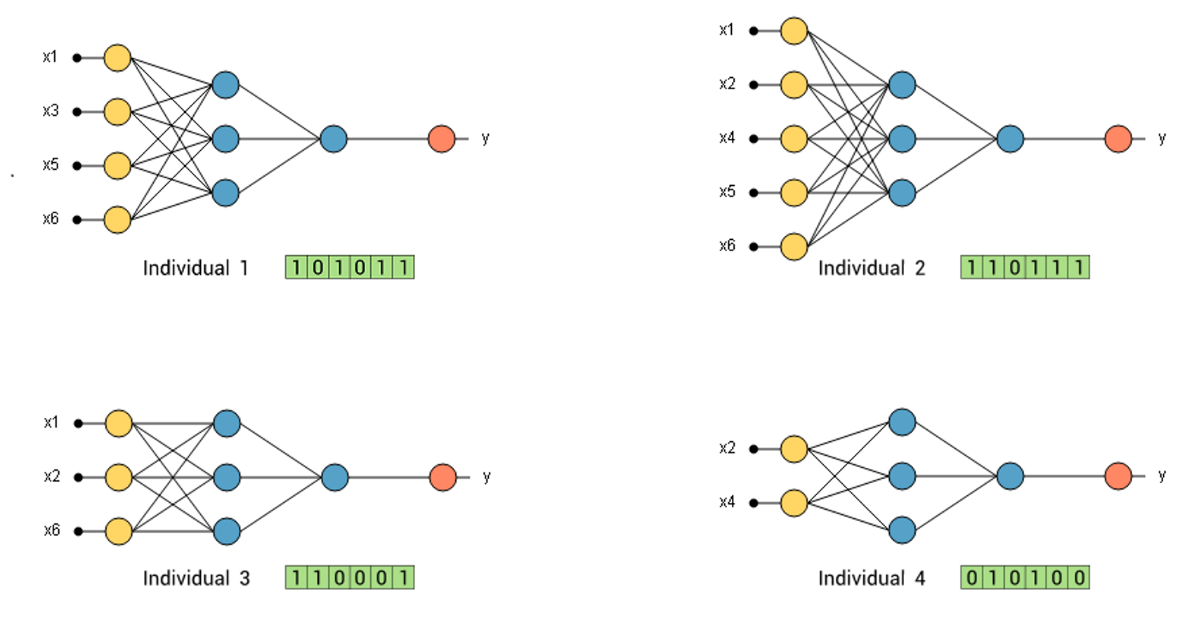
B) Research: GA
The most common task to find parameters at which a particular function reaches its maxima value
Black-box
Gene Encoding
Adaptive GA
Determine fitness function and architecture of genetic algorithms
Can an adaptive approach to selecting GA parameters be applied

Slide 76
C) Applied: E-TCN
Can TCN networks design and hyper parameters be optimized through evolutionary techniques?
Does a genetic algorithm perform better with high-dimensional and seasonal big data challenges such as market data?
Can we improve accuracy and performance of the deep neural networks?
Apply TCN network design and genetic algorithm approach to time series problem
Goal: Compare backpropagation to evolutionary approach
Output experiments across

Slide 77
D) Applied: E-TCN
Can Knowledge driven events that cause abrupt changes be incorporated into the model?
Can an adaptive continuous learning adaptive approach be applied (streaming market data and news data)?
Results of experiments in complete design
Knowledge driven events (negative effects causing abrupt changes)
Incorporate abrupt model (negative effect)
Continuous learning (stream real-time data)
Output experiments across more recent designs (knowledge graphs / news events / current stock data)

Slide 78
Appendix
Charts

Slide 79
Lessons Learned Last time
Sector | Expand Before Peak | Peak | Contraction After Peak | Trough | Expansion After Trough
Real-estate | + | - | - | - | +
Technology | + | + | - | - | +
Industrials | + | + | - | - | +
Oil | - | + | + | - | -
Consumer | + | + | - | + | +
The biggest surprise in this analysis is the explainable AI features that drive importance of the business cycle over the last two cycles. This shows that the indicators of CPI, Technology, Real-estate, Industrials and Oil as being good indicators of overall analysis of the business cycle.
Notes:
A business cycle approach to asset allocation can add additional insights as part of a intermediate to longer term strategy. Although each business cycle is different, this analysis suggests that there is a cyclical pattern in the economy and performance in asset categories in the macro and sector do show some correlation.
The biggest surprise in this analysis is the explainable AI features that drive importance of the business cycle over the last two cycles. This shows that the indicators of CPI, Technology, Real-estate, Industrials and Oil as being good indicators of overall analysis of the business cycle.
Indicator
Description
CPI (Macro) Consumer price index measure changes in the price level of a weighted average market basket of consumer goods and services purchases by households
Technology (Sector) Price and yield performance of publicly traded equity securities of companies in the technology select sector index.
Real estate (Sector) Price and yield performance of publicly traded equity securities of companies that purchase office building, hotels and other real property.
Industrials (Sector) Tracks the stocks of some of the largest companies in the US economy; large CAP US equities (e.g. MSFT, BA, HD, AMGN, UNH, DIS, JNJ)
Oil (Macro) Crude oil prices
When combined with the analysis we see the relative performance therefore having business cycle insights can provide insights into more economically sensitive sectors as related to more defensively oriented sectors.
Early – expand before peak - Sectors that typically benefit most from low interest rates—such as consumer discretionary, financials, and real estate which we also see in our analysis
Peak – during this phase the technology stocks
Contraction shows that Oil and by proxy energy stocks to do
Recession shows that consumer staples tend to do better – where revenues are tied to basic needs
Expansion after trough matches the expand before peak
Economic researchers (Ibbotson et al.) state that economic factors influence asset prices, however there is still research required to determine the best way to incorporate economic factors into asset allocation approaches. The impact of the pandemic entered the US into a contraction after peak cycle that was not influenced by other economic factors. There is debate whether we should have eliminated that period from the analysis however it still provides valuable insights to the impact on sector and macro indicators. Today the problem with business cycle analysis is research centers such as NBER are not timely in their analysis (their last announcement of recession was a full 12 months after the fact). Leveraging the full AI model with the 12 data sources continues to predict that we are still in the contraction after peak phase of the business cycle. We believe with a disciplined business cycle approach that we can better predict the natural phases of the economy and better analyze the underlying factors and trends across various time horizons through the use of both macro and sector data sources.

Slide 80
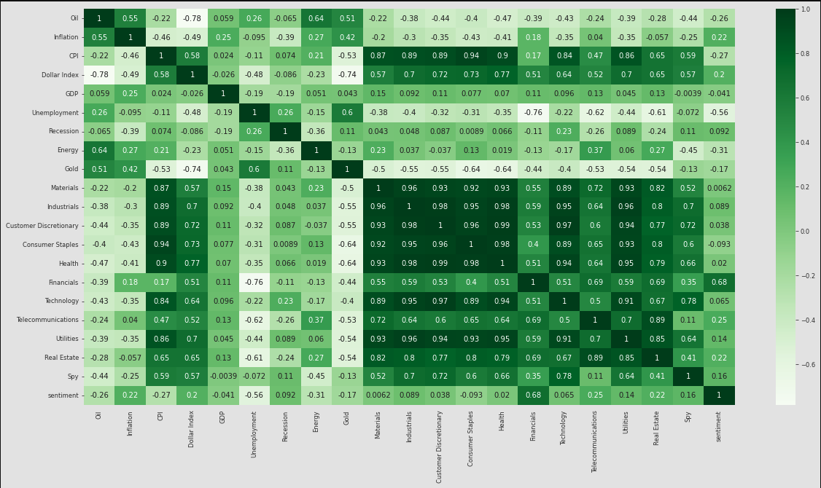
Correlation
Economic sentiment
World conflict?
Oil?
Industrials?
Technology?
Look at multidimensional on sentiment (not just positive/negative)
– are there elements beyond an aggregate sentiment?

Slide 81
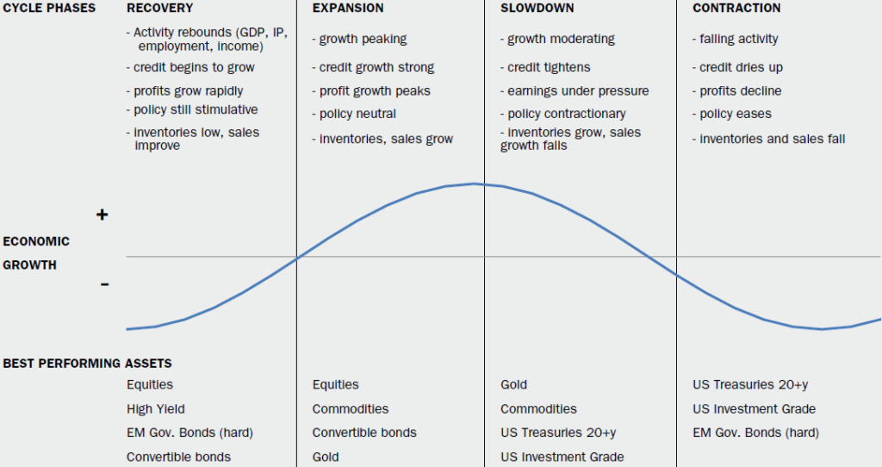
Problem statement prediction
Our approach seeks to identify shifting economic phase and provide a framework for making asset allocation decisions according to the probability that asset may outperform or underperform.
In intermediate-term how is asset performance driven by interest rates and inflation?
Can we determine sector performance based on the business cycle (early, mid, late, recession)?
Can we manage extrapolation bias (too much emphasis on recent price movements)?
Can we improve accuracy of phase identification?
Notes:
Over the intermediate term, asset performance is often driven largely by cyclical factors tied to the state of the economy—such as corporate earnings, interest rates, and inflation. The business cycle, which encompasses the cyclical fluctuations in an economy over many months or a few years, can therefore be a critical determinant of asset market returns and the relative performance of various asset classes.
Specifically, there are 4 distinct phases of a typical business cycle (see chart below):
Early-cycle phase: Generally a sharp recovery from recession, marked by an inflection from negative to positive growth in economic activity (e.g., gross domestic product, industrial production), then an accelerating growth rate. Credit conditions stop tightening amid easy monetary policy, creating a healthy environment for rapid margin expansion and profit growth. Business inventories are low, while sales growth improves significantly.
Mid-cycle phase: Typically the longest phase of the business cycle. The mid cycle is characterized by a positive but more moderate rate of growth than that experienced during the early-cycle phase. Economic activity gathers momentum, credit growth becomes strong, and profitability is healthy against an accommodative—though increasingly neutral— monetary policy backdrop. Inventories and sales grow, reaching equilibrium relative to each other.
Late-cycle phase: Often coincides with peak economic activity, implying that the rate of growth remains positive but slows. A typical late-cycle phase may be characterized as an overheating stage for the economy when capacity becomes constrained, which leads to rising inflationary pressures. While rates of inflation are not always high, rising inflationary pressures and a tight labor market tend to crimp profit margins and lead to tighter monetary policy.
Recession phase: Features a contraction in economic activity. Corporate profits decline and credit is scarce. Monetary policy becomes more accommodative and inventories gradually fall despite low sales levels, setting up for the next recovery.

Slide 82
Dataset – Federal reserve
Oil | Inflation | CPI | Dollar Index | GDP | Unemployment | Business Cycle
Table that shows all macro, all sector and broad asset classes
Crude Oil (https://fred.stlouisfed.org/series/DCOILWTICO) – 1986 - 2021
Dollars per barrel
Inflation (https://fred.stlouisfed.org/series/T10YIE) -2003 .- 2021
The latest value implies what market participants expect inflation to be in the next 10 years, on average
CPI (https://fred.stlouisfed.org/series/CPIAUCSL) - 1947 – 2021
A measure of the average monthly change in the price for goods and services paid by urban consumers between any two time periods. It can also represent the buying habits of urban consumer
Trade Weighted Dollar Index (https://fred.stlouisfed.org/series/DTWEXAFEGS) – 2006 – 2021
A measure of the US dollar to other world currencies
Real Gross Domestic Product (https://fred.stlouisfed.org/series/A191RL1Q225SBEA) – 1947 - 2021
Gross domestic product (GDP) is the value of the goods and services produced by the nation's economy less the value of the goods and services used up in production
Unemployment (https://fred.stlouisfed.org/series/UNRATE) – 1948 – 2021
The unemployment rate represents the number of unemployed as a percentage of the labor force
Recession Data (https://fred.stlouisfed.org/series/USREC) – 1854 – 2021
This time series is an interpretation of US Business Cycle Expansions and Contractions data provided by The National Bureau of Economic Research
Notes:
Key takeaways
The business cycle reflects the aggregate fluctuations of economic activity, which can be a critical determinant of asset performance over the intermediate term.
Changes in key economic indicators have historically provided a fairly reliable guide to recognizing the business cycle's 4 distinct phases—early, mid, late, and recession.
Our approach seeks to identify the shifting economic phases, providing a framework for making asset allocation decisions according to the probability that assets may outperform or underperform.
For example, the early cycle phase is typically characterized by a sharp economic recovery and the outperformance of equities and other economically sensitive assets.
This approach may be incorporated into an asset allocation framework to take advantage of cyclical performance that may deviate from longer-term asset returns.
A business cycle approach to asset allocation can add value as part of an intermediate-term investment strategy.

Slide 83
Sector data – Yahoo time series
Adding ETF sector data will provide insights on confirming the ETFs that perform better during a business cycle
https://finance.yahoo.com/etfs/
ETF | Sector
XLE (Energy Select) | Energy
GDX (Gold) | Gold Miners
XLB | Materials
DIA | Industrials
XLY | Consumer Discretionary
XLP | Consumer Staples
XLV | Health Care
XLF | Financials
XLK | Technology
IYZ | Telecommunication
XLU | Utilities
VNQ | Real estate
SPY | S&P 500

Slide 84
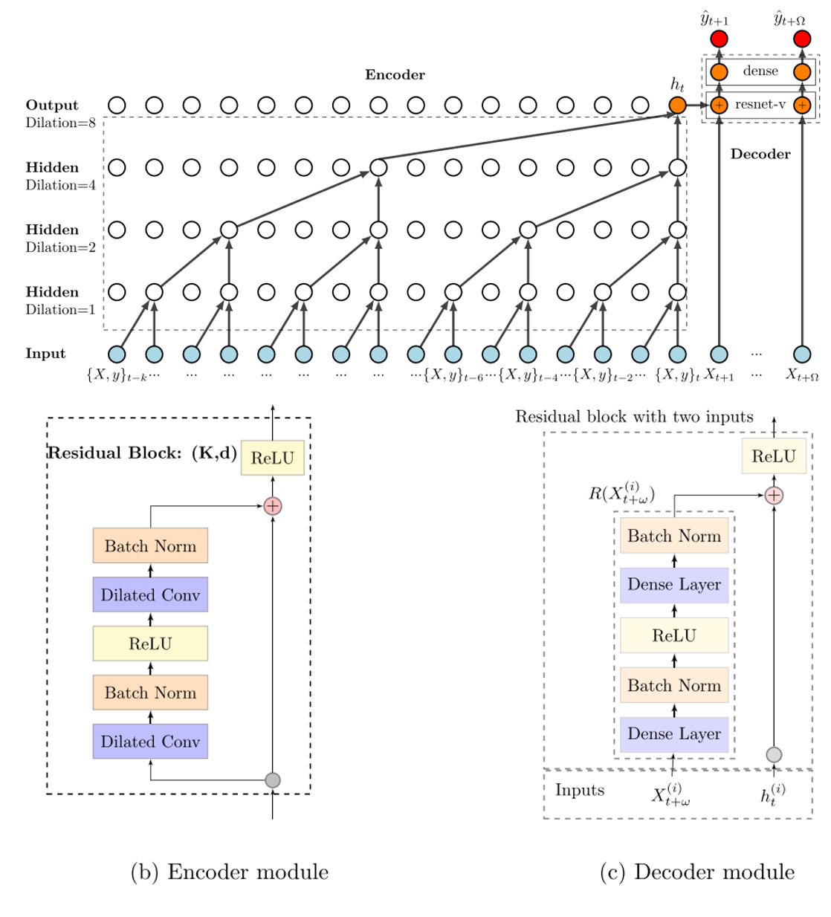
Newer concepts

